Slide 1
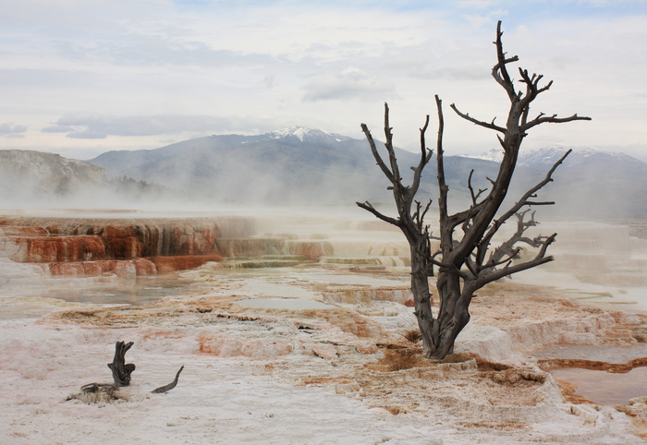
Class 13:
Selfish Mining (Supersized)
Cryptocurrency Café
UVa cs4501 Spring 2015
David Evans

Slide 2
Plan for Today
Quiz 2 [Spurlock Video]
Quiz 2 Discussion
Selfish Mining

Slide 3

http://youtu.be/uLxhI81Flvk?t=18m43s

Slide 5
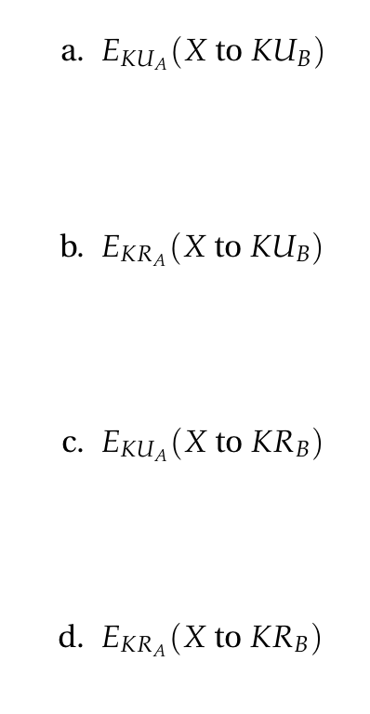

Slide 7
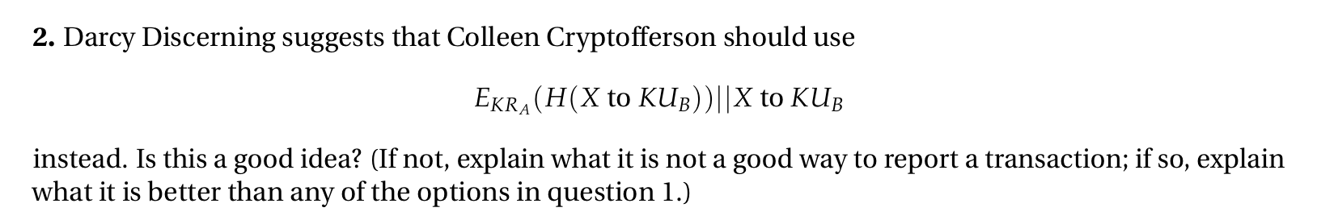

Slide 9
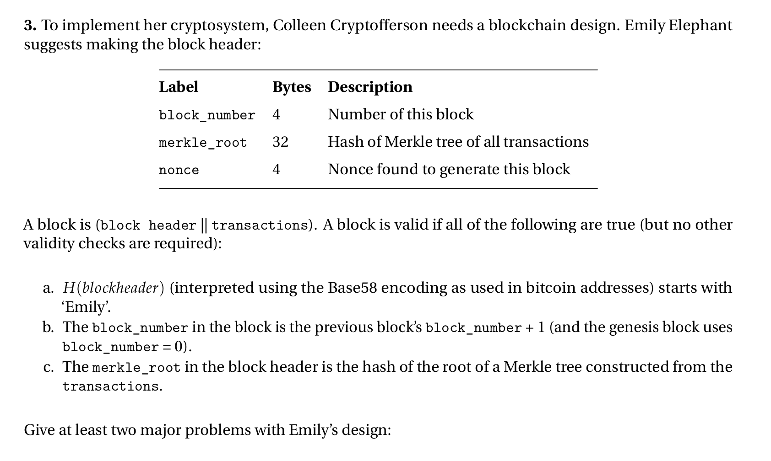

Slide 11
http://youtu.be/uLxhI81Flvk?t=18m43s

Slide 13
Selfish Mining

Slide 16


Slide 17
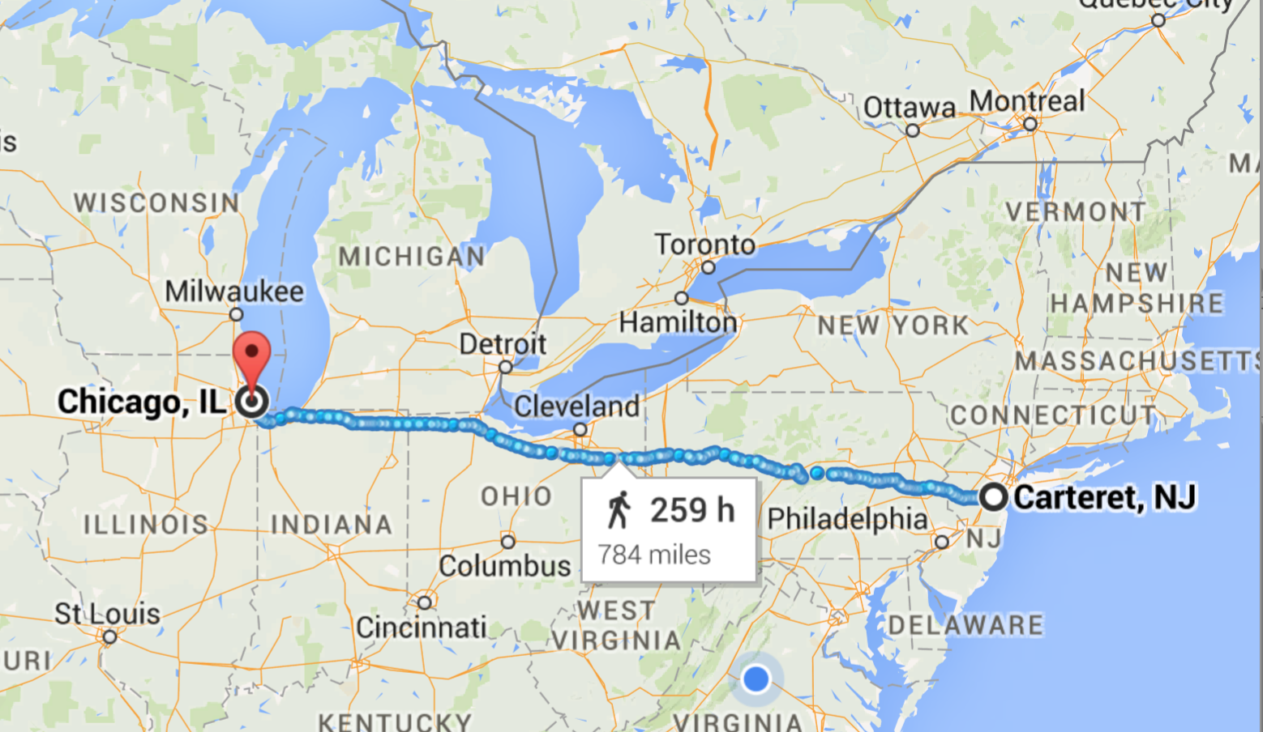

Slide 18
Normal network: 17 ms
Spread Networks ($300M): 13 ms
Chicago Mercantile Exchange
NASDAQ Data Center

Slide 19
Normal network: 17 ms
Spread Networks ($300M): 13 ms (827 miles)
Microwave Links: ~9 ms
1260 km / 299792 km/s = 4ms at lightspeed
Chicago Mercantile Exchange
NASDAQ Data Center

Slide 20
Pooling Miners
https://www.antpool.com/poolStats.htm

Slide 21
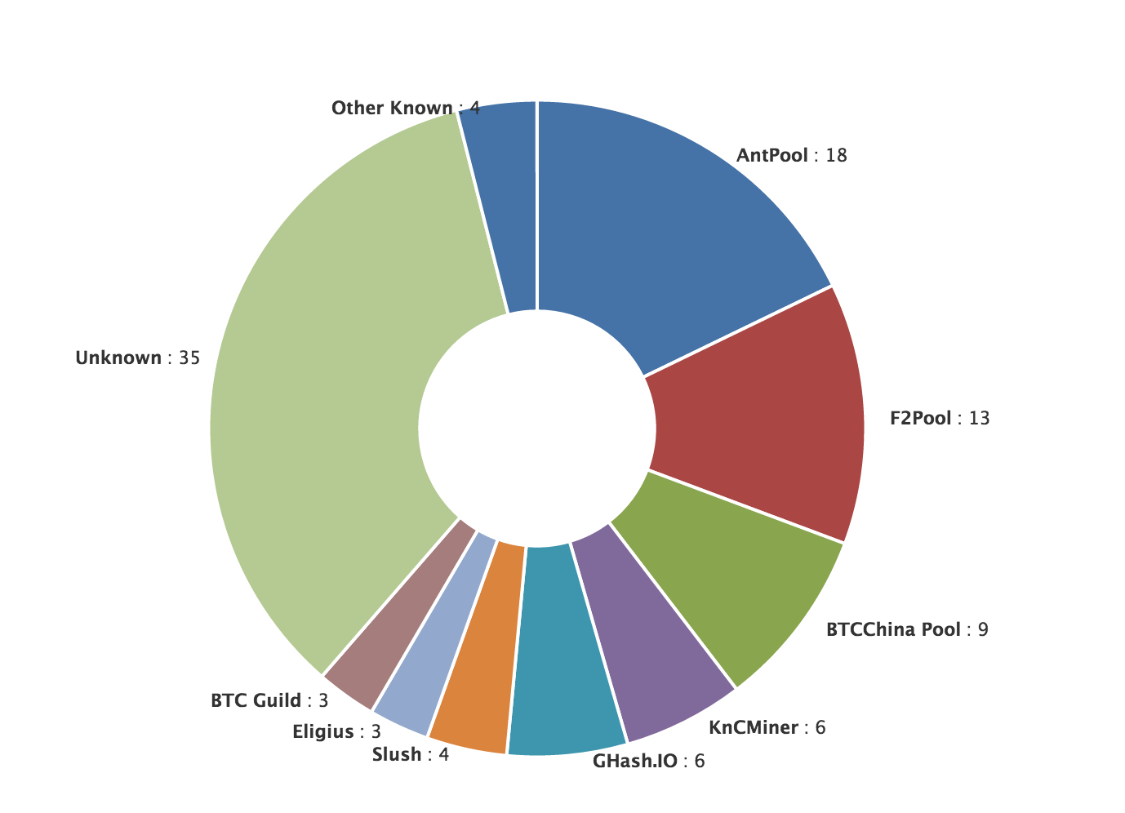
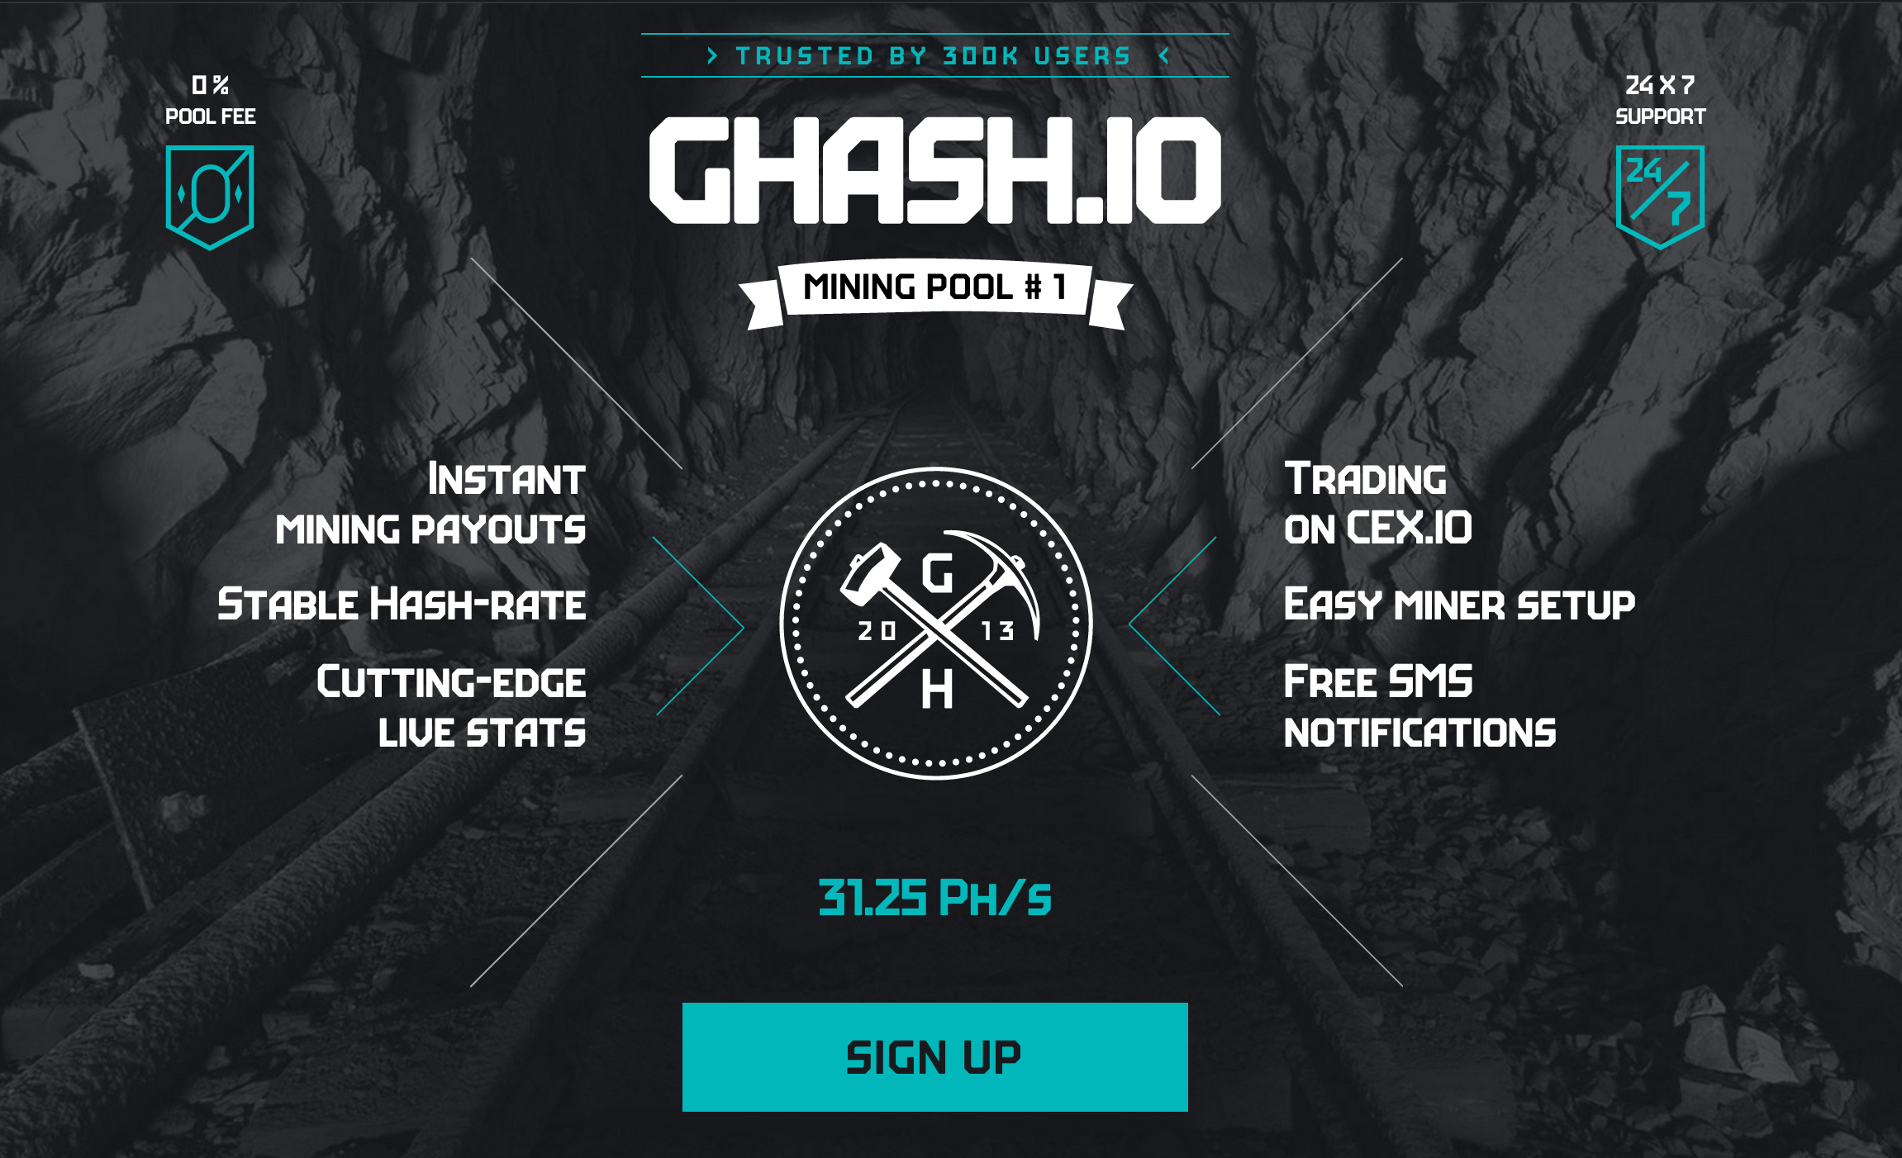
Mining Pool Dangers

Slide 22
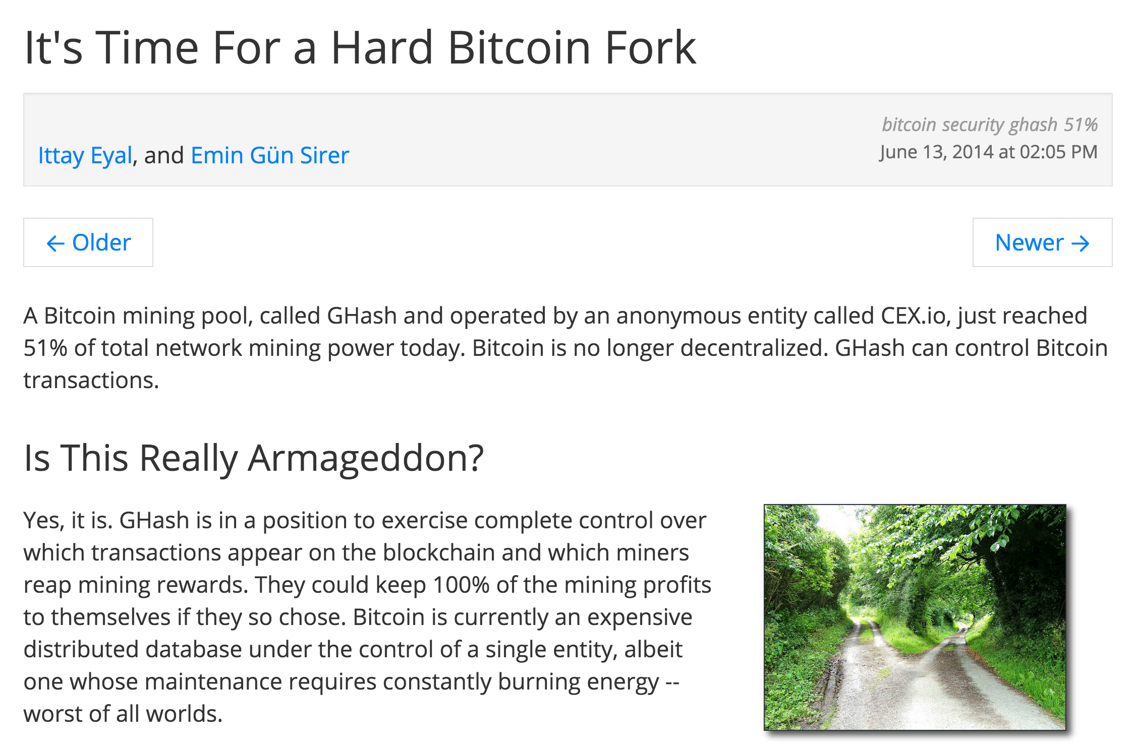

Slide 23
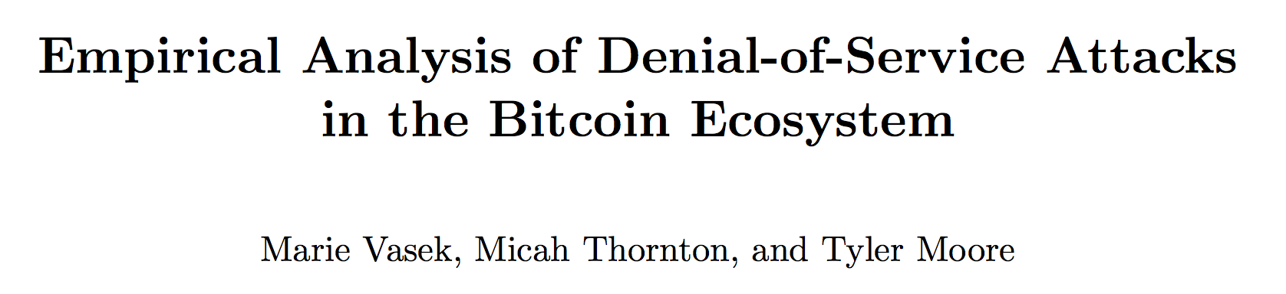
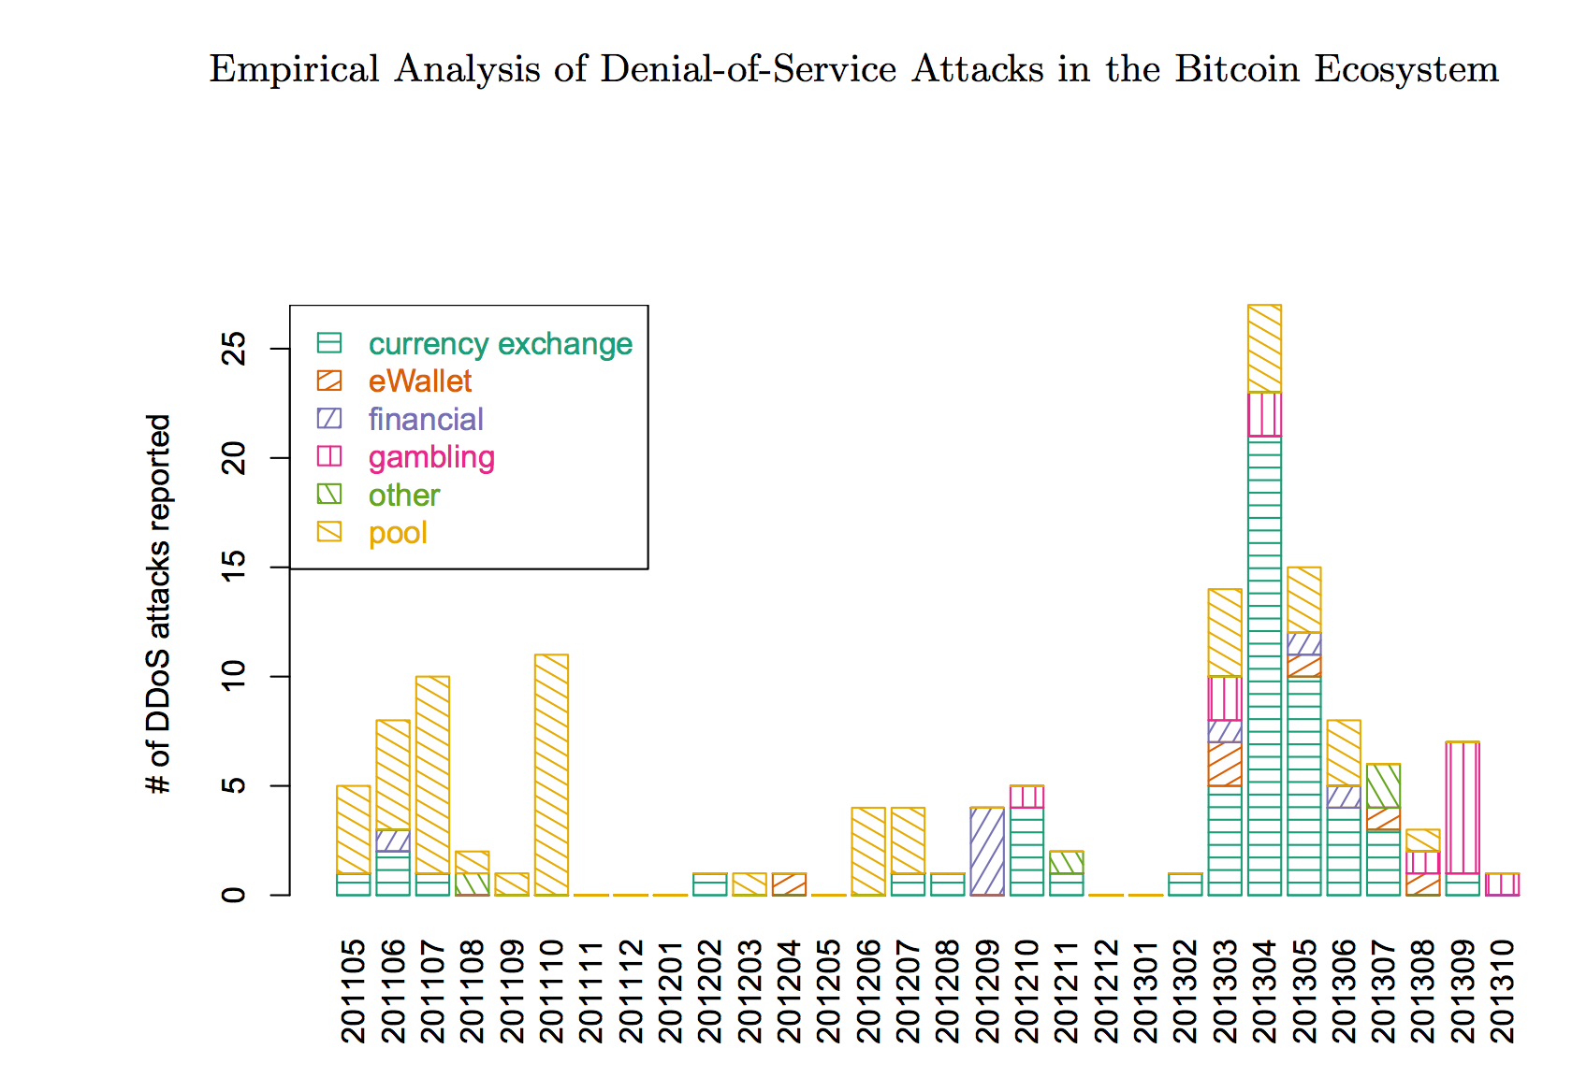
Mining Pool Attacks
DDOS-ing
Block Withholding
Lots of interesting questions about this and ongoing research…we’ll talk more in future classes. Many possible project ideas about mining pool dangers and attacks on mining pools.

Slide 24
Charge
Project 2 Part 2:
Due Thursday 5 March

